Slide 1




Photo-Inspired Model-Driven 3D Object Modeling
Kai Xu^{1,2} Hanlin Zheng³ Hao (Richard) Zhang² Daniel Cohen-Or⁴ Ligang Liu³ Yueshan Xiong¹
¹National Univ. of Defense Tech. ²Simon Fraser Univ.
³Zhejiang Univ. ⁴Tel-Aviv Univ.
Notes:
Good afternoon … First I’d like to say that our original presenter Kai, the first author, should be given credited for doing most of the work and also most of the slides … But unfortunately, he could not come to SIGGRAPH. It was first a visa issue but he did get his visa yesterday and booked a flight to arrive last night, but then his flight was cancelled due to a storm in Beijing. Quite a long story ….

Slide 2
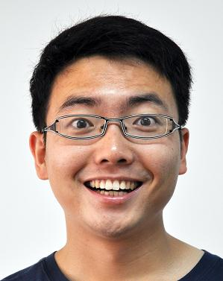
Photo-Inspired Model-Driven 3D Object Modeling
Kai Xu^{1,2} Hanlin Zheng³ Hao (Richard) Zhang² Daniel Cohen-Or⁴ Ligang Liu³ Yueshan Xiong¹
¹National Univ. of Defense Tech. ²Simon Fraser Univ.
³Zhejiang Univ. ⁴Tel-Aviv Univ.
Notes:
So this is Kai … at least he still seems to be happy ;)

Slide 3
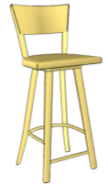
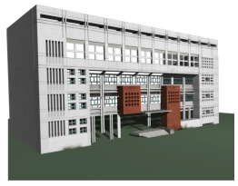
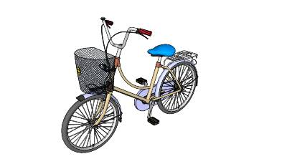
3D content creation
Inspiration a readily usable digital 3D model
Inspiration?
Notes:
This paper is a little bit different. The problem addressed is 3D content creation.
The ultimate goal of 3D content creation is to quickly turn an inspiration into a readily usable digital 3D model, and ideally making it possible even for a non-expert modeler.

Slide 4
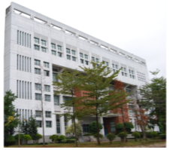
Realistic reconstruction
[Nan et al., 2010]
Inspiration = real-world data
Notes:
The inspiration can certainly come from real-word captured data, then we have a reconstruction problem.

Slide 5
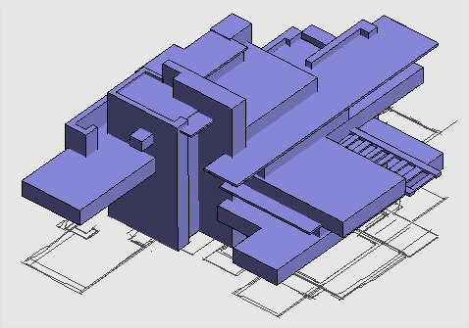
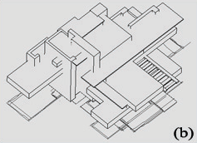
Creative inspiration
Creation of novel 3D shapes
Inspiration = design concept, mental picture, …
sketch
Notes:
Our goal is the creation of novel shapes, where the inspiration would come from some design concept, a mental picture, perhaps a 2D sketch …

Slide 6

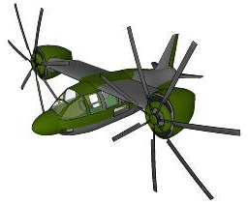
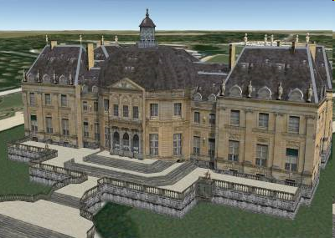
3D content creation is hard
2D-to-3D: an ill-posed problem:
Shape from shading, sketch-based modeling, …
3D creation from scratch is hard: job for skilled artists
One of the most fundamental problems in graphics
Jim Kajiya’s Award Talk: Geometric modeling still hard!
Notes:
Interacting with 2D designs is certainly convenient for us, but 3D content creation from a 2D design is hard since the 2D-to-3D mapping is an ill-posed problem.
To create a 3D model with moderate complexity would take a lot of effort even for a skilled artist.
3D modeling or content creation really lies at the heart of CG, but after much effort, it is still a hard problem today … this is nicely echoed by Jim Kajiya’s Award Talk on Monday, which is very inspirational for me and our work.

Slide 7
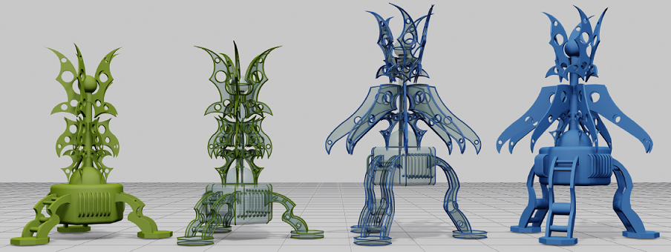
Usable 3D content even harder
Models created are meant for subsequent use
Editing, modification, generation of new models …
iWires [Gal et al. 2009]
Notes:
And to cap it all, creating ***usable*** 3D content is especially hard!
Geometric modeling is a continuous process, we are not done after creating a model … the model will be continuously edited, deformed, and used to generate new models …

Slide 8
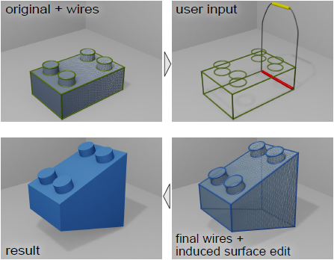
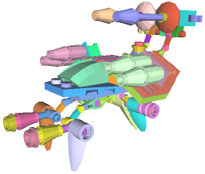
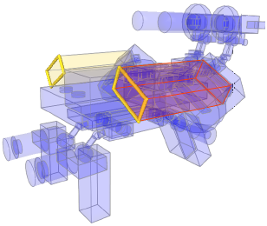
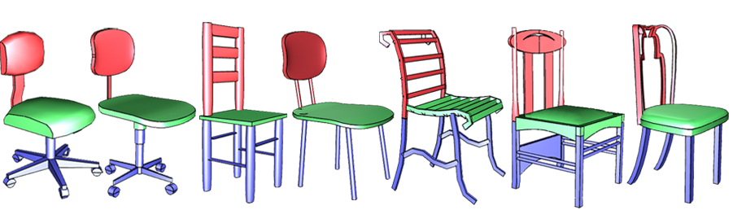
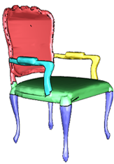
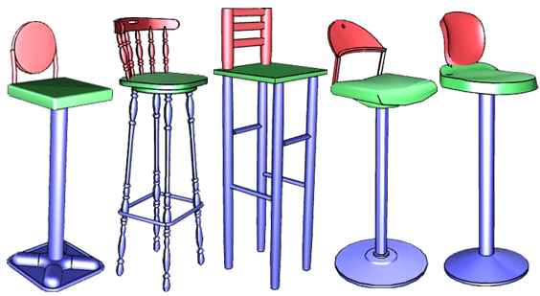
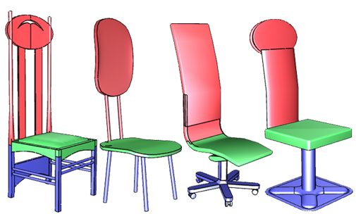
Usable 3D content even harder
Creation of readily usable models
Part information (segmentation) or characteristic curves (wires)
Structural relations between parts/wires
Correspondence among relevant models: co-segmentation, etc.
Hard shape analysis problems, esp. for man-made models
Component-wise controllers
[Zheng et al. 2011]
Co-segmentation
[Xu et al. 2010]
iWires [Gal et al. 2011]
Notes:
To facilitate these modeling tasks, it is essential for the model to possess useful feature or structural information …
To obtain such structural information is not easy; these are all hard shape analysis problems, especially for man-made models, our focus, since they are so structure-rich.

Slide 9
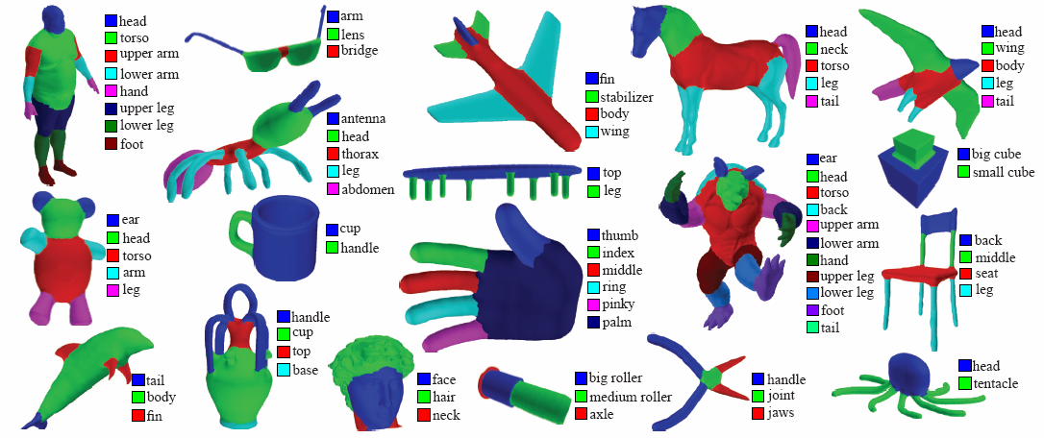
Key: model reuse
Reuse pre-existing 3D models
Particularly their pre-analyzed structures
Not only serve to evaluate, but also to create
Segmentation benchmarks
[Chen et al. 2009, Kalogerakis et al. 2010]
Notes:
We believe that the key to creating readily usable 3D models is model reuse! Reuse of existing 3D models and particularly their pre-analyzed structures.
Now such pre-analyzed datasets do exist, in some cases, large ones, for benchmark evaluation of mesh segmentation; and we just saw one for shape mapping.
With such effort to come up with these datasets, it makes sense to utilize them fully.
In our work, we show that these valuable data can be used not only to evaluate, but also to CREATE!

Slide 10
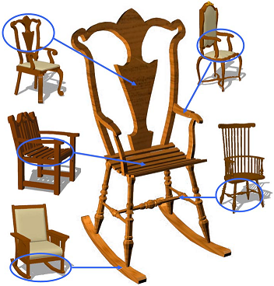
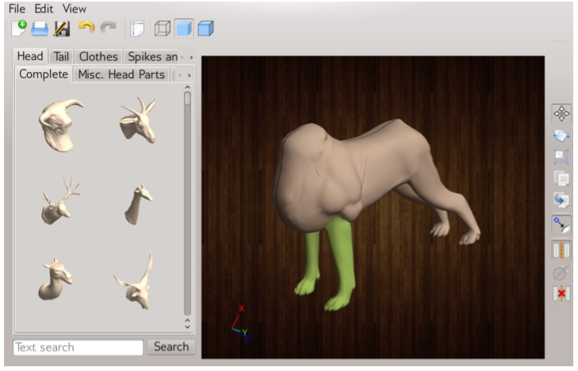
Key: model reuse
Two primary modes of reuse:
New creation via part re-composition
Pre-existing structural information can be lost …
Modeling by example
[Funkhouser et al. 2004]
Data-driven part suggestions
[Chaudhuri et al. , 2010 & 2011]
Notes:
Thinking about model reuse, there are two primary paradigms …
Perhaps the most classic one is to compose parts from existing models.
This can be traced back to the seminal work on modeling by example and there have been quite a lot of follow-ups including papers from this year at SIGGRAPH.
However, an issue with this approach is that the pre-analyzed structural info in the models will likely be destroyed when parts are taken from different shapes and recomposed.

Slide 11
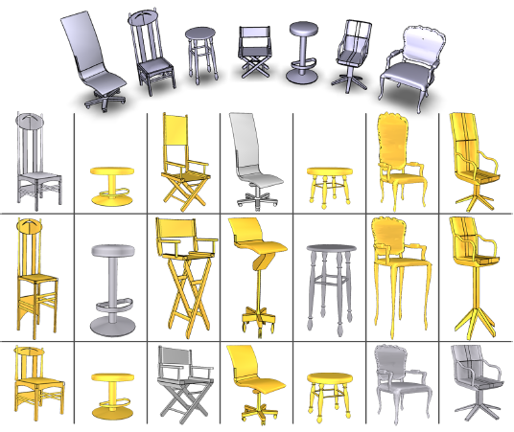
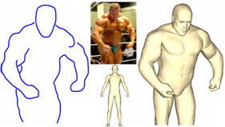
Key: model reuse
Two primary modes of reuse:
New creation via part composition
New creation as a variation of existing models, e.g, a warp or deformation
Appearance-driven, organic shapes
Varying part scales
[Xu et al. 2010]
[Kraevoy et al. 2009]
Notes:
An alternative to model reuse is to create a variation of existing models!
There have been some works along this line, e.g., Xu et al. vary the part scales of the models and Kraevoy et al. developed a deformation method that is appearance-driven and worked on organic shapes; it is not structure-driven, which will be the focus of our work.

Slide 12
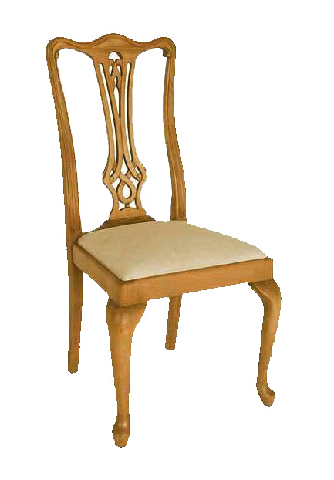
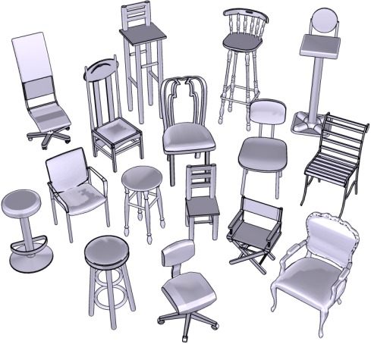
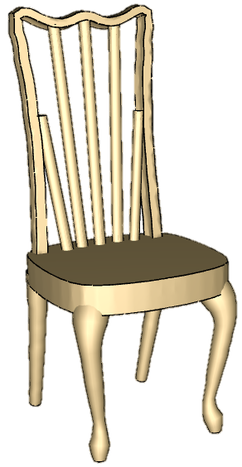
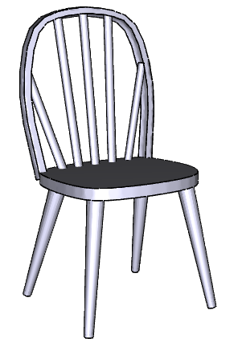
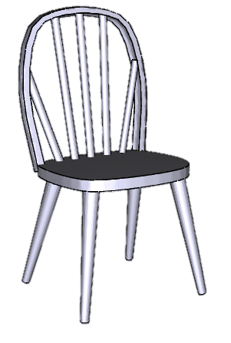
Model-driven 3D content creation
Generate variations from a pre-analyzed candidate model set
Notes:
So we take this second approach … We utilize a pre-analyzed candidate model set and the final creation is a variation of a selected candidate.

Slide 13
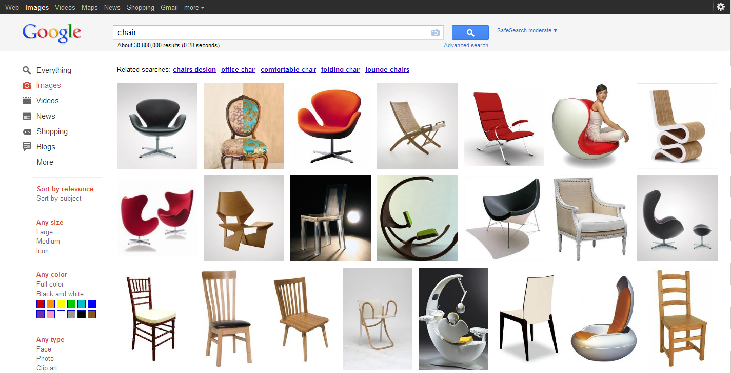
Photo-inspired 3D modeling
Photographs: one of the richest source of modeling inspiration
On-line photographs, often only in single-views
Notes:
As for inspiration, we go for photographs, which provides one of the richest source of modeling inspirations. In particular, we would like to utilize the vast number of on-line photographs.
Of course, such photographs are often available only in single-views.

Slide 14
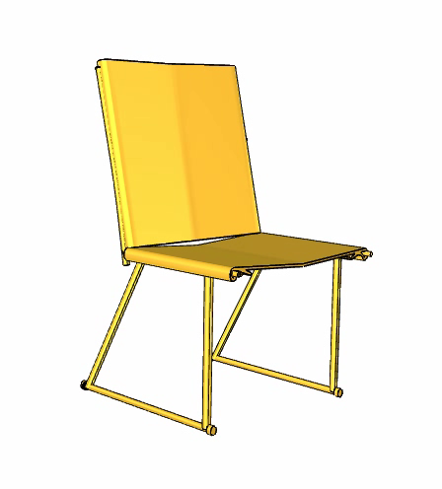
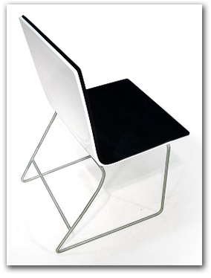
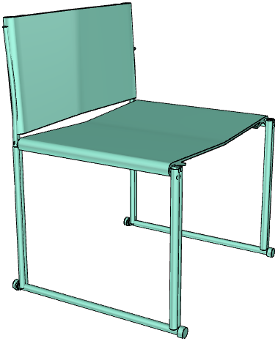
Key features
Single photo coherent and structure-preserving 3D model
Photograph
Retrieved candidate 3D model
3D creation
Notes:
So our problem is finally set. We take a single photo and create a 3D model that resembles the object captured in the photo.
Even though our algorithm is guided by only one view of the object, the model is coherent in 3D in all views. More importantly, it preserves any structural information available in the candidate.

Slide 15
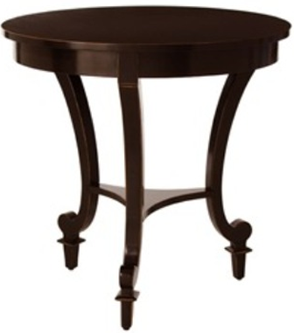
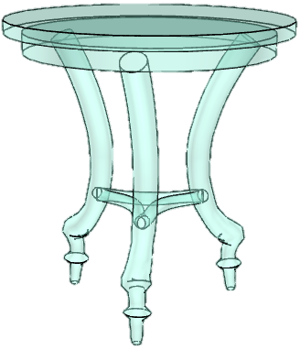
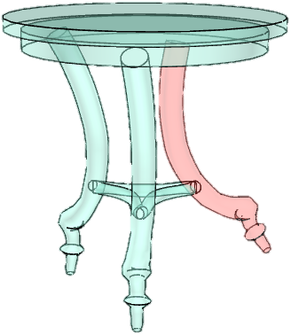
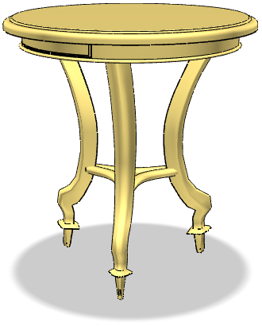
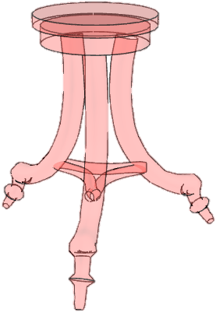
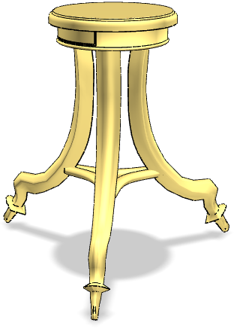
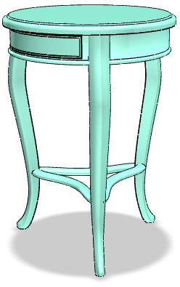
Creation readily usable
Subsequent model editing
Notes:
Here’s another example

Slide 16
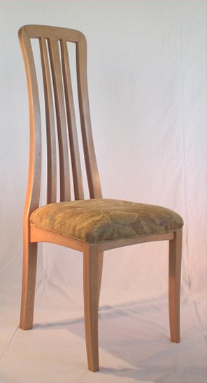
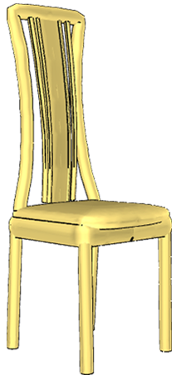
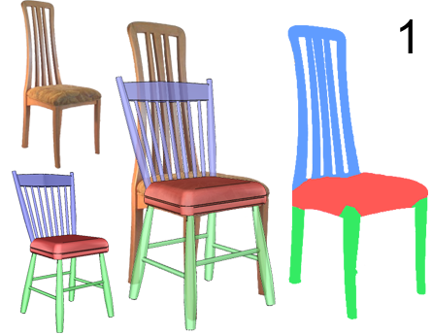
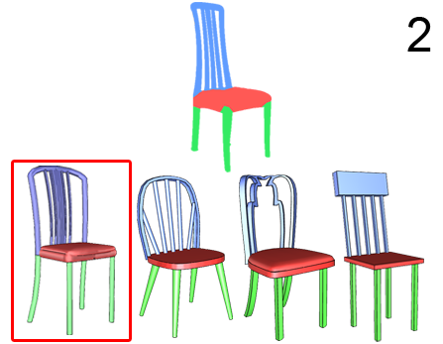
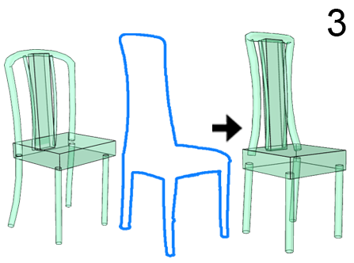
Overview
Notes:
Now let us see how we do this … here is an overview …
Given a photograph that contains an object we want to model,
We utilize a pre-analyzed data set composed of 3D models belonging to the same class as the object in the photo.
Then, we use the object in the photo as query to retrieve a representative 3D model from the data set.
The representative model is used to guide the labeled segmentation for the object in the photo
Using this part labeling information as constraint, in the second step, we can perform a refined retrieval, which returns a 3D model that is more similar to the object in the photo,
This model is used as the candidate model on which we perform a *** silhouette driven warp *** to make it better resemble the object in the photo.
As we can see, the resemblance to the photographed object is through silhouette matching between the 3D model and the 2D image.

Slide 17
Pre-analyzed candidate model set
Part correspondence [Xu et al. 2010]
Input model set
Models in part correspondence
Notes:
For the candidate model set, one of the key structures is meaningful correspondence across the set. Here we utilize the method of Xu et al. to compute a co-segmentation of the set despite the differences in the part scales.

Slide 18
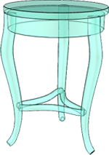
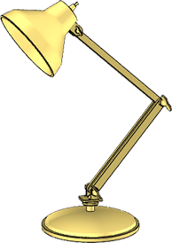
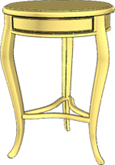
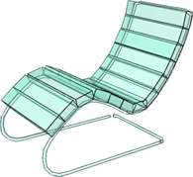
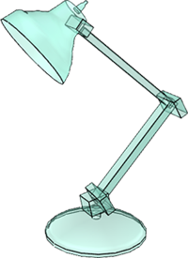
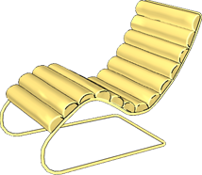
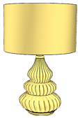

Pre-analyzed candidate model set
Component-wise controllers [Zheng et al. 2011]
Controller primitives: cuboids and generalized cylinders
Interrelations: symmetry, proximity, etc.
Notes:
Another important task of pre-analysis is to enable effective deformation, which we use for silhouette-driven warp.
For this, we adopt the component-wise controller framework of Zheng et al.
In our work, we consider only two types of controllers, i.e., cuboids and generalized cylinders
We also extract the interrelations for the controllers, such as symmetry and proximity.
The controllers together with the structural information will be used in the silhouette driven deformation

Slide 19
Overview of our method
Step 1:
Model-driven image-space object analysis
Notes:
Let’s now take a look at the first step, model-driven image-space object analysis

Slide 20






Model-driven image-space object analysis
Retrieval of representative model
Model-driven labeled segmentation
Graph cut segmentation
Notes:
Given a photograph, we first extract the foreground object we want to model using the GrabCut technique.
Using the 2D contour as query, we retrieve from the model set a ROUGH representative model,
Since the data set has been consistently segmented beforehand,
We can use the part labeling in the representative model to guide the labeled segmentation of the object in the photograph.
Specifically, we overlay the representative model on top of the photo and project its labeled parts onto image space, and use the projected regions to bootstrap a graph cut segmentation.
Here, there is a view alignment problem, which is a hard computer vision problem … we do not employ or develop anything advanced, we combine some simple view filtering with user assistance to perform the view estimation and alignment between 3D model and the photograph; more technical details can be found in the paper. The amount of user assistance is rather minimal compared to the usual effort required for 3D model creation.

Slide 21
Overview of our method
Step 2:
Candidate model retrieval
Notes:
The second step is candidate model retrieval,
Here we show that with the labeled segmentation, we can perform a refined retrieval with part level shape descriptor, to obtain a 3D model that is more similar to the object in the photograph

Slide 22












Candidate model retrieval
whole shape Light Field Descriptor
Top 5 retrieved results
Query
Notes:
First, we see here the result of using one of the best shape descriptors for whole shapes. That is the light field shape descriptor. There are certainly a few false positives.

Slide 23








Candidate model retrieval
part-level Light Field Descriptor
Top 5 retrieved results
Query
Candidates may be randomly chosen --- modeling surprise
Notes:
In contrast, comparing shapes at the part level allows for better retrieval results and this is possible with the labeled segmentation we just obtained.
Here it is important to note that while we have developed ways to retrieve a 3D candidate that closely matches with the photo, this is just to minimize the effort for deformation. For the purpose of creating more novel shapes, it is not necessary to do a careful retrieval, the deformation step which I will describe next can even take a randomly chosen 3D candidate and this might even lead to a more creative modeling surprise.

Slide 24
Overview of our method
The key step 3:
Silhouette-driven deformation
Notes:
The last step, silhouette-driven deformation, is the key step …

Slide 25
Silhouette-driven deformation
Four sub-steps:
Silhouette correspondence
Initial controller reconstruction
Controller optimization
Underlying geometry deformation
Notes:
This step contains four sub-steps: silhouette correspondence, controller reconstruction, controller optimization, and underlying geometry deformation

Slide 26

Silhouette-driven deformation
Silhouette correspondence
Initial controller reconstruction
Controller optimization
Underlying geometry deformation
Notes:
Given a photograph and a candidate model represented by component-wise controllers,

Slide 27


Silhouette-driven deformation
Silhouette correspondence
Initial controller reconstruction
Controller optimization
Underlying geometry deformation
Notes:
We first extract the silhouettes of the object in photograph
and also the silhouette of the 2D projection of the whole set of controllers

Slide 28

Silhouette-driven deformation
Silhouette correspondence
Initial controller reconstruction
Controller optimization
Underlying geometry deformation
Notes:
Then we compute point correspondence between the two silhouettes using graph matching

Slide 29


Silhouette-driven deformation
Silhouette correspondence
Initial controller reconstruction
Controller optimization
Underlying geometry deformation
Notes:
Then we over-segment each silhouette, and construct segment correspondence based on the point correspondence we have computed

Slide 30

Silhouette-driven deformation
Silhouette correspondence
Initial controller reconstruction
Controller optimization
Underlying geometry deformation
Notes:
With the correspondence in hand, we can reconstruct the shape, position, orientation of the individual controllers guided by the silhouette of the object in the photograph … the outer controllers. This is the initial controller construction …

Slide 31

Silhouette-driven deformation
Silhouette correspondence
Initial controller reconstruction
Controller optimization
Underlying geometry deformation
Notes:
The reconstruction is constrained by the shape characteristics of the individual controllers.

Slide 32

Silhouette-driven deformation
Before optimization
After optimization
Silhouette correspondence
Initial controller reconstruction
Controller optimization
Underlying geometry deformation
Notes:
Because the silhouette guidance is only in a single PERSPECTIVE view, the shape and structure of the reconstructed controllers may be incorrectly reconstructed just based on silhouette correspondence.
Therefore, we perform controller optimization to recover the structure which was pre-analyzed in the candidate model

Slide 33
Silhouette-driven deformation
Before optimization
After optimization
Final geometry
Silhouette correspondence
Initial controller reconstruction
Controller optimization
Underlying geometry deformation
Notes:
Finally, we deform the underlying geometry based on the deformation of the individual controllers

Slide 34


Structure optimization at work
Initial controller
reconstruction
Front-view
Notes:
Now let’s take a closer look at the structure optimization in the silhouette driven warp
As mentioned before, controllers reconstructed from a single view may not be satisfactory as you can see from the front-view of the warped controllers to the right. This is mainly because that we did not deal with the perspective projection issue.

Slide 35




Structure optimization at work
Individual controller symmetry
Inter-controller symmetry
proximity constraints
Initial configuration
Final configuration
iterative
Notes:
To alleviate this problem, we propose a greedy and iterative approach to structure optimization
In each iteration, we perform three operations to greedily optimize the structure of the controllers, including the recovery of individual controller symmetry, inter-controller symmetry, and the proximity between adjacent controllers.
When the optimization converges, we obtain the final configuration as shown in the right

Slide 36

Results
Candidate not always chosen as best so as to show the power of silhouette-driven warp

Slide 37


Tables
Notes:
Here we show more results obtained by our method … tables

Slide 38


Lamps
Notes:
lamps

Slide 39




The Google Chair Challenge
Notes:
Before describing the algorithm, we first show a few results from a stress test which we called the Google Chair Challenge. The photo inspirations come from returns from a Google image search … as we can see, the results are fairly successful …

Slide 40


The Google Chair Challenge

Slide 41


The Google Chair Challenge

Slide 42

The Google Chair Challenge
?
Notes:
But not without exceptions though …

Slide 43


The Google Chair Challenge

Slide 44


The Google Chair Challenge

Slide 45
Conclusion and limitations
Photo-inspired model-driven 3D content creation
Utilizes two rich sources: photo inspirations and pre-analyzed 3D models
Structure-driven image analysis and silhouette-based deformation
Readily usable: variation less “intrusive” to retain pre-analyzed structures
Limitations:
Variation does not create new structures, e.g., new connectivity or topology
Modeling at the coarse level, refined modeling to follow
Resemblance to photographed object is only through silhouette matching
Conflicts may occur between constraints to be enforced
Notes:
To conclude, our modeling approach exploits the immensely rich source of modeling inspiration from photographs
Secondly, our silhouette driven warp can lead to better resembling with respect to the object in the photo
Finally, we believe that modeling as a variation is less intrusive to retain the high level information of the source model
One of the disadvantages of variation is that it does not create new structures.

Slide 46


Conflicting constraints
Random candidate

Slide 47

Future work
Photo-inspired model deformation only a start
Other inspirations for 3D content creation
Sketch-inspired model variation
Interior feature curves
Notes:
We believe our paper is only a first step along the direction of photo-inspire model deformation
In future, we’d like look at model-driven structure modification, aiming at the creation of new structure
Another possible direction is to explore more kinds of inspirations for 3D content creation, such as user’s 2D sketch

Slide 48
Future work
Photo-inspired model deformation only a start
Other inspirations for 3D content creation
Sketch-inspired model variation
Interior feature curves
Bigger questions
A common high-level structural representation, for individual or a set? −−− low-level mesh reps seem like the wrong choice for modeling
Easy creation of new structures (topology) that well retain pre-analyzed structures −−− from geometry creation to structure creation
Notes:
We believe our paper is only a first step along the direction of photo-inspire model deformation
In future, we’d like look at model-driven structure modification, aiming at the creation of new structure
Another possible direction is to explore more kinds of inspirations for 3D content creation, such as user’s 2D sketch

Slide 49
Acknowledgement
Anonymous reviewers
The authors of [Zheng et al. EG 2011]
Aiping Wang from NUDT
Grants
NSERC (No. 611370)
Doctoral Program of Higher Education of China (No. 20104307110003)
the Israel Science Foundation
National Natural Science Foundation of China (61070071)
973 National Key Basic Research Foundation of China (No. 2009CB320801).
Notes:
Finally, we’d like to thank the anonymous reviewers, people who have provided help and our grants

Slide 50


Thank you!
Project page: http://www.kevinkaixu.net/k/projects/photo-inspired.html

